Slide 1

Emerging Markets’ Appetite for Sovereign Risk: Exploring Relationship between EM GDP Output, Commodity Prices and Sovereign Risk
By Ishaan Mahadevan
Data Bootcamp
July,10 2019

Slide 2
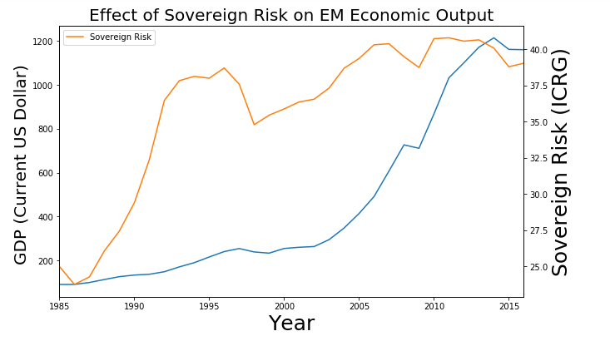
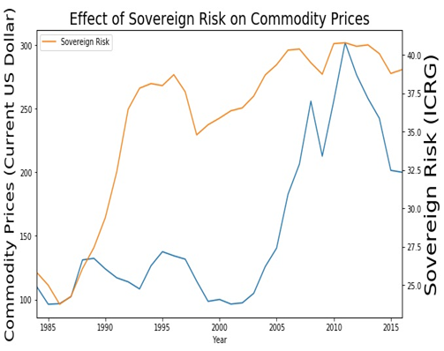
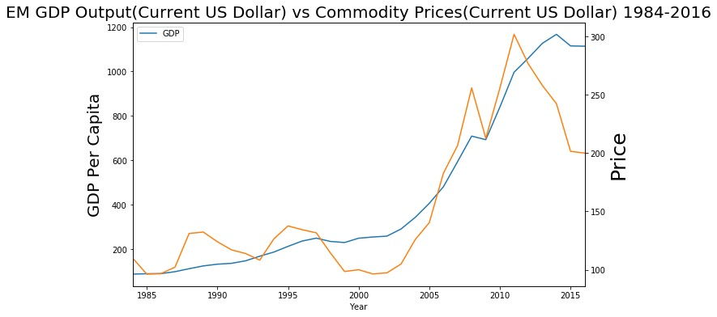
Historical Trends
Throughout the last twenty years, EM GDP Output has had more of a direct relationship with Commodity Prices.
Coincidentally, Sovereign Risk also has been experiencing similar patterns with EM GDP Output and Commodity Prices

Slide 3
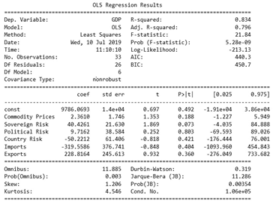

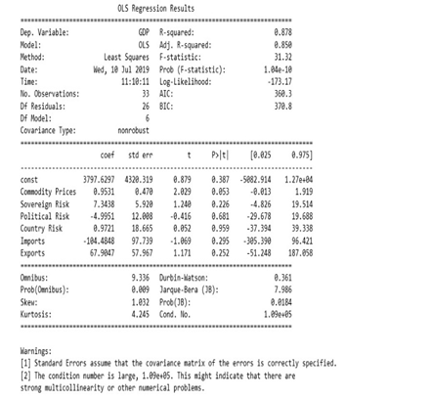
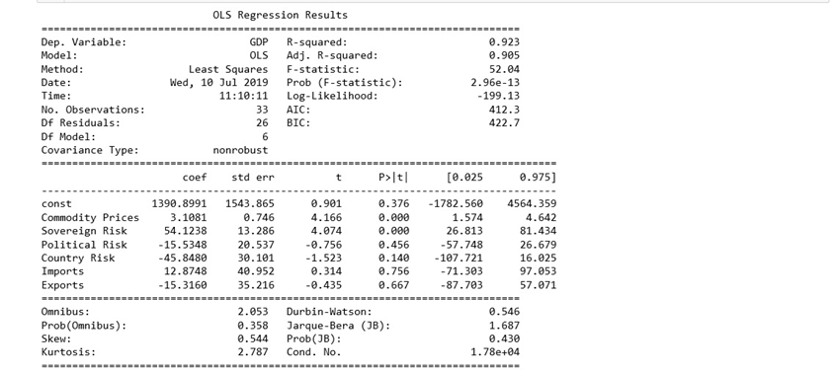

Sovereign Risk is relatively the Biggest Risk for EM GDP Output and Commodity Prices
Each multivariate regression model, regardless if it has China, BRICS, or only BRICS, share a high Sovereign Risk coefficient.
Among BRIC EMs and non-BRIC EMs, Sovereign Risk is a bigger variable to consider in contrast to Political Risk and Country Risk
Using Machine Learning Classification, during 2017-2023 Sovereign Risk is 85% likely to highly impact GDP
Does not mean to ignore one risk factor for another risk factor when looking at fluctuations between EM GDP output and commodity prices.

Slide 4
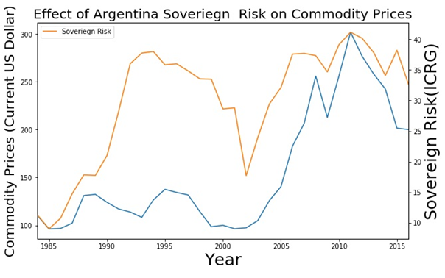
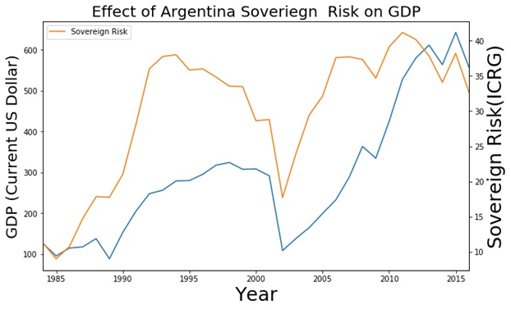

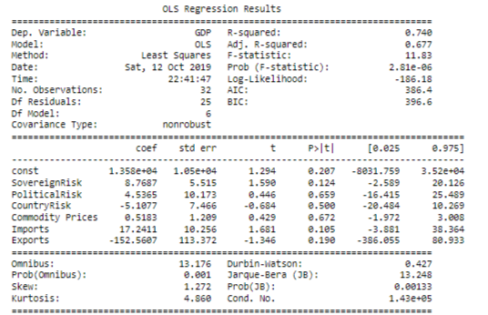
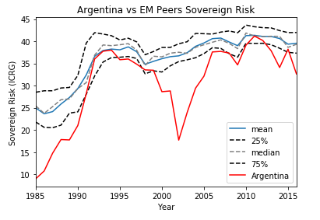
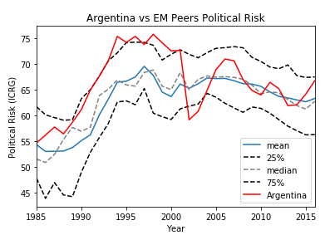
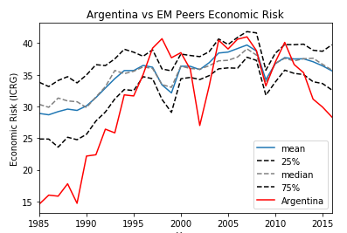
Argentina
Despite strong Political and Economic factors helping economy rebound, Sovereign Risk prevented Prices to significantly impact GDP positively
Using Machine Learning Classification, Sovereign Risk is 42.8% likely from 2017 to 2023 to have a high impact on GDP

Slide 5
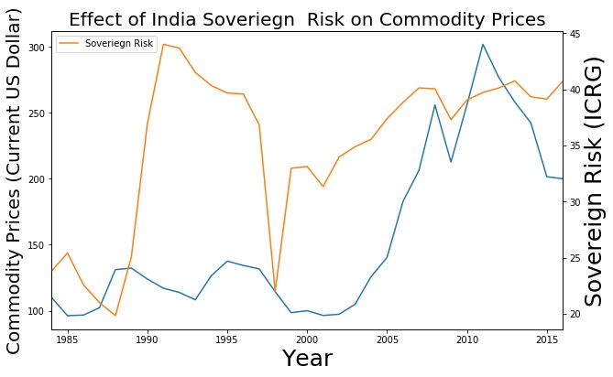
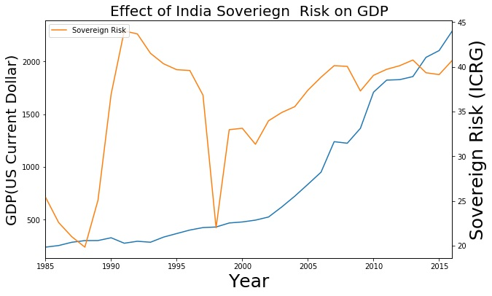

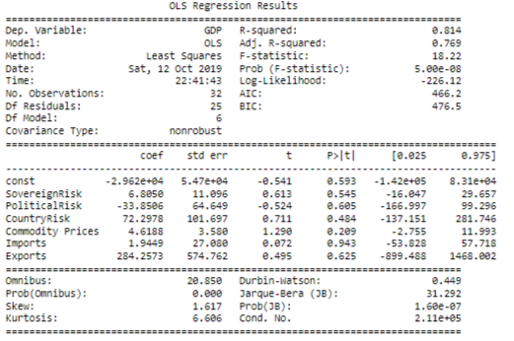
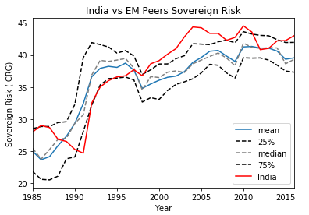
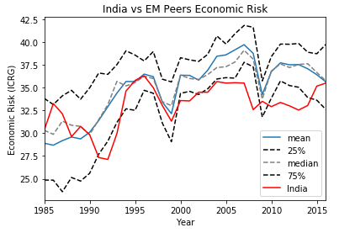
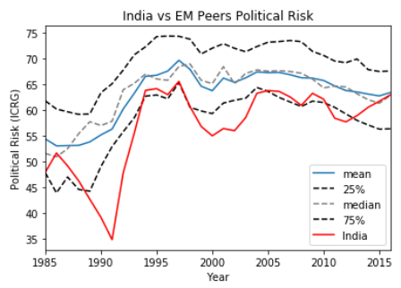
India
Economic slowdowns and Economic rebounds are not just only dependent on Sovereign Risk, but Country Risk too.
Despite showing strong financial robustness, India’s GDP and Commodity prices are still greatly impacted by Political and Economic elements combined.
Using Machine Learning Classification, Country Risk is 100% likely to highly impact GDP from 2017 to 2023

Slide 6
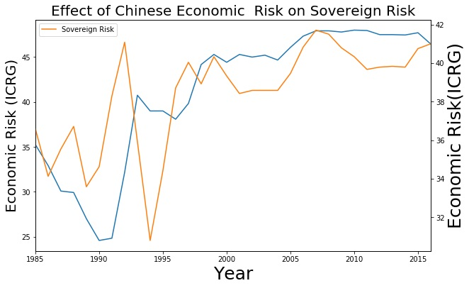
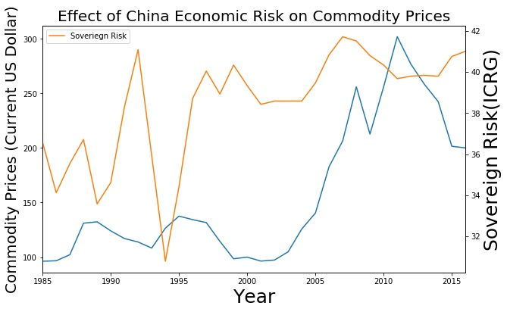

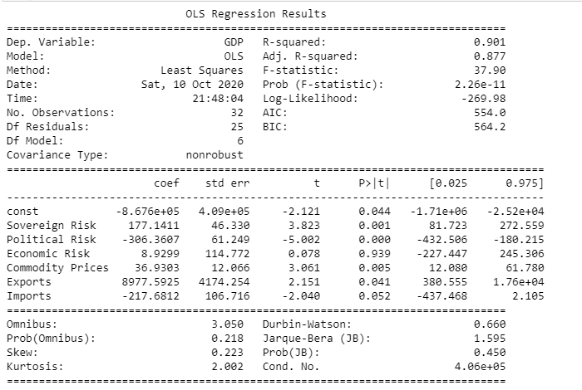
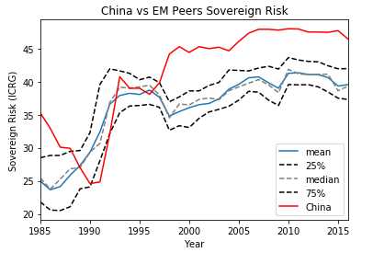
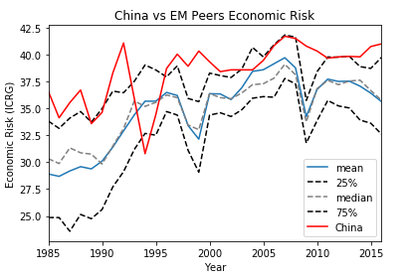
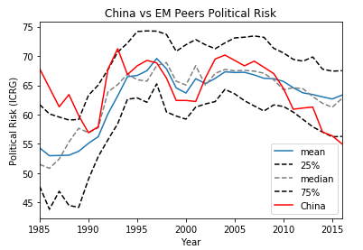
China
Despite focus on Country, Sovereign, and Political Risk, also important to look at Economic Risk in relation to GDP, Commodity Prices, and Sovereign Risk outside of Political Influences.
Economic Health has a strong influence on Sovereign Risk, which impacts Sovereign Risk influence on Commodity Prices and Economic Output.
Using Machine Learning Classification, Economic Risk is 100% likely to highly impact GDP and Sovereign Risk from 2017 to 2023.

Slide 7
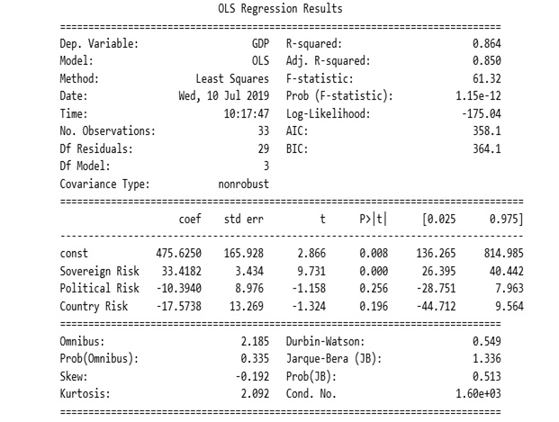

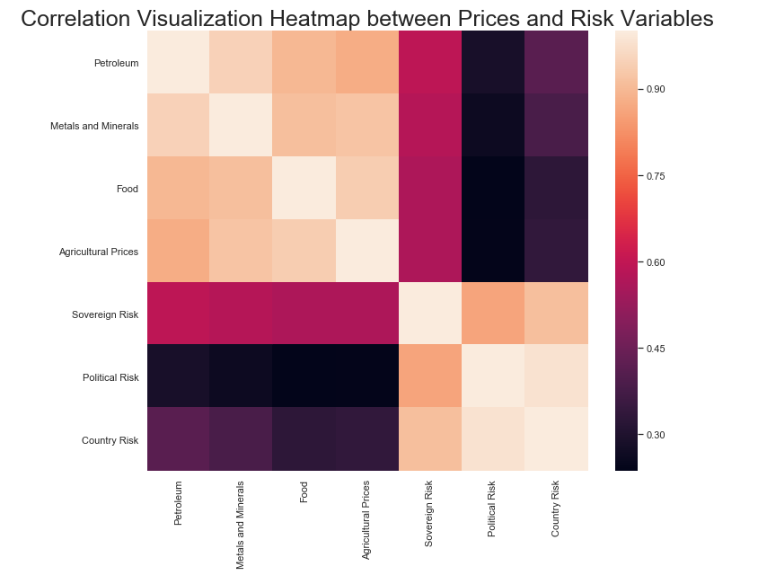
Food For Thought
Commodity Prices and EM GDP output are greatly impacted by Sovereign Risk
Important to understand political and economic variables that impact the positively correlated relationship between Commodities and EM GDP Output
Don’t forget to consider Economic Health

